Slide 1
CHƯƠNG TRÌNH ĐÀO TẠO NHÂN VIÊN
MÔN HỌC: CSS
SASS
Trình bày:
Sơn VQ
Duy LD
Thái NQ
Cương NTK
Thắng NN
HANOI – JUN, 2015
6/15/15
www.qsoftvietnam.com
1
Notes:
1

Slide 2
Object-oriented CSS
Why we need Sass
Introduction to Sass
Part I
Variable, Nest, Mixin
Extend, Import

Slide 3
Math, Loop, Condition, Function
Introduction to Compass
Disadvantages of Sass
Part II
Sass Vs Less
Tool, Cheat sheet, Best practices

Slide 4
Object-oriented CSS
Why we need Sass
Introduction to Sass
Part I
Variable, Nest, Mixin
Extend, Import

Slide 5
What is object-oriented CSS?
A methodology of writing reusable CSS that is fast, scalable and maintainable.

Slide 6
TWO MAIN PRINCIPLE
1. Separate Structure and Skin
2. Separate Container and Content

Slide 7
SEPARATE STRUCTURE AND SKIN
Separating positioning (position, float, margin, etc.) from styling (background, color, border, etc.)

Slide 8
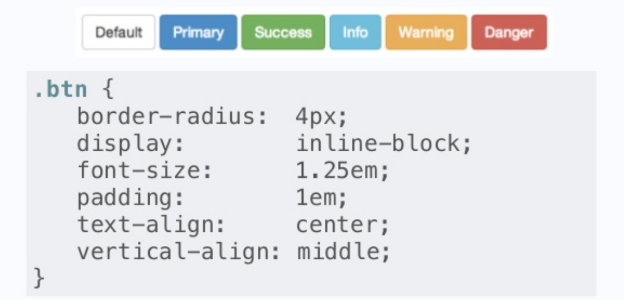

Slide 9
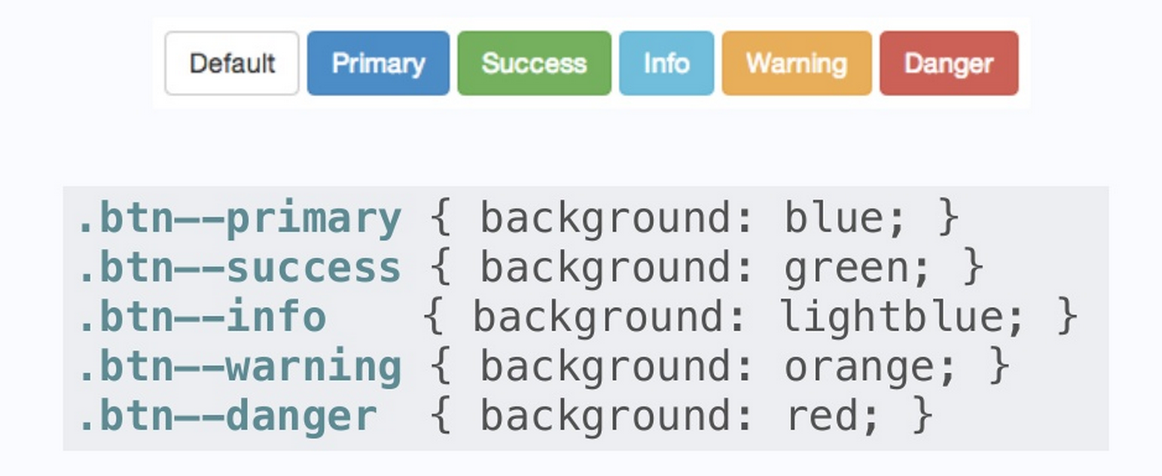

Slide 10
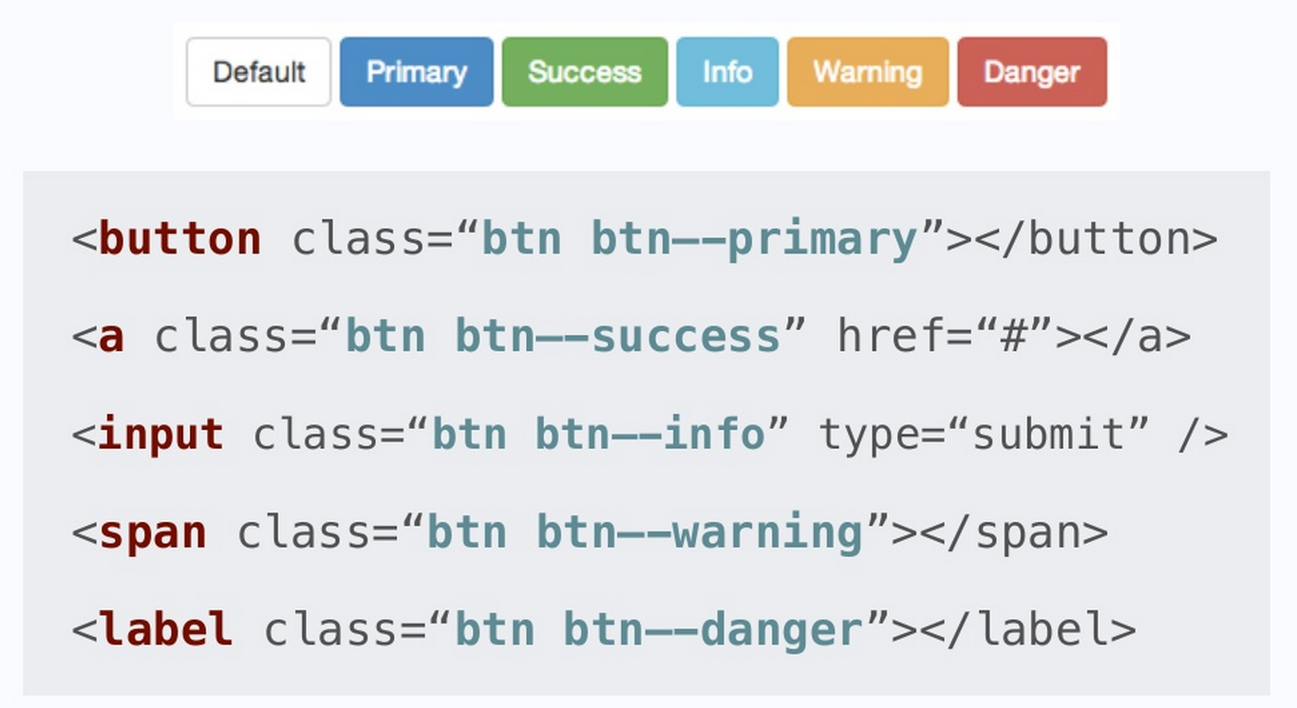

Slide 11
SEPARATE CONTAINER AND CONTENT
Objects should look the same
no matter where you put them

Slide 12
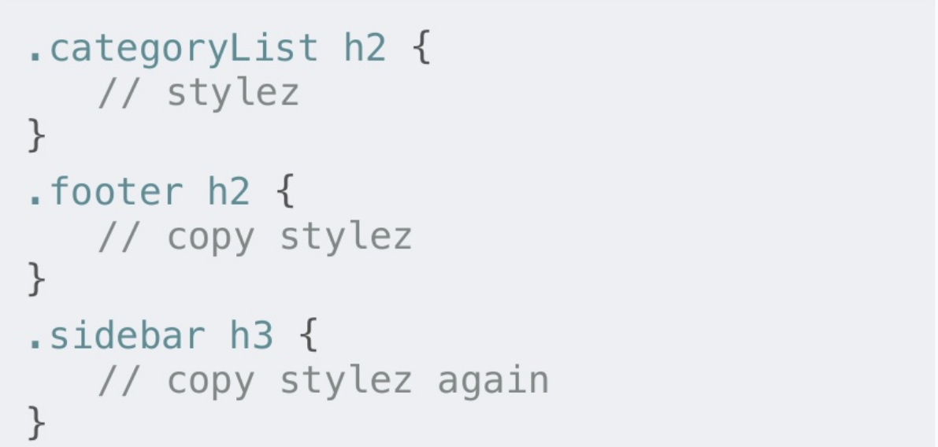
BAD

Slide 13
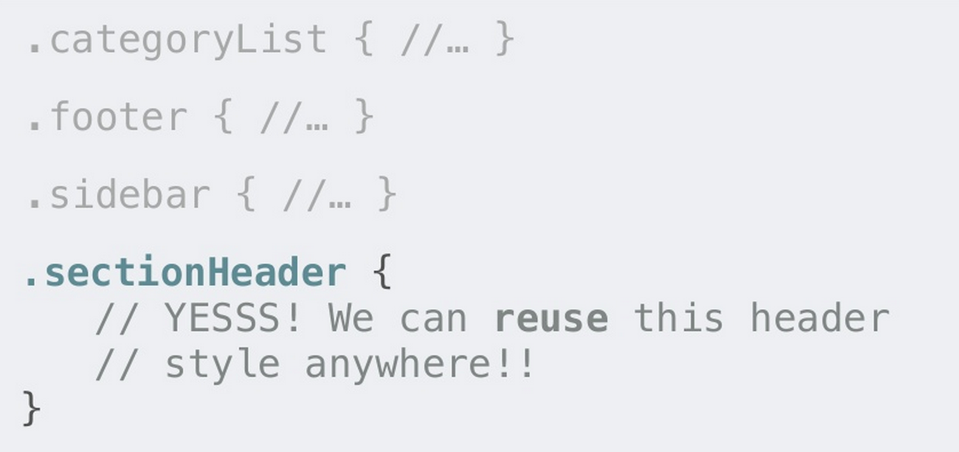
THE RIGHT WAY

Slide 14
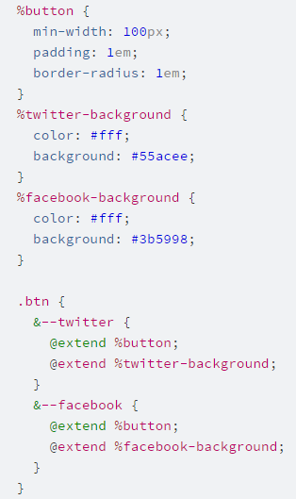
SASS WAY

Slide 15
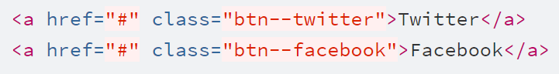
SASS WAY

Slide 16
IMPORTANT NOTES
Avoid styling ID selectors
Avoid attaching class to element selectors, ie. a.sub-title
Avoid styling descendent selectors, ie. .sidebar .recent-post ul li
Avoid !important

Slide 17
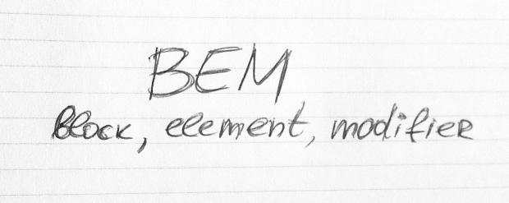
YOU SHOULD READ

Slide 18
Object-oriented CSS
Why we need Sass
Introduction to Sass
Part I
Variable, Nest, Mixin
Extend, Import

Slide 19

6/15/15
www.qsoftvietnam.com
19

Slide 20
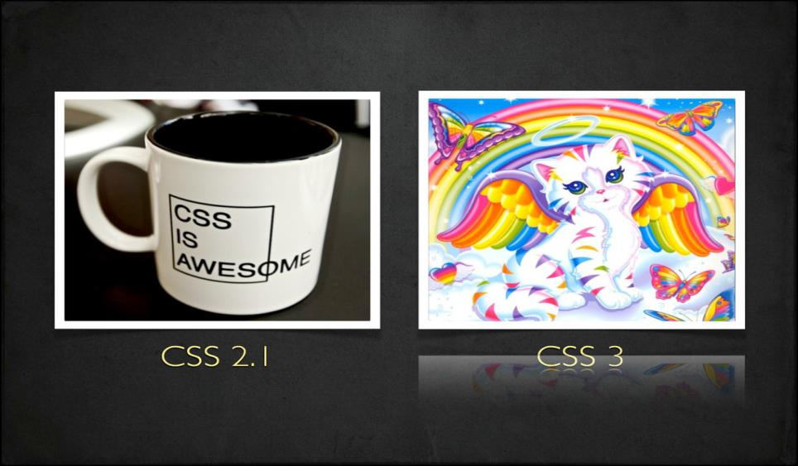
6/15/15
www.qsoftvietnam.com
20

Slide 21

Good Speed
Work on my phone
Wow, 3D animation!
New Fonts
Multiple browser support
Colorful
Unbelievable
What they see
6/15/15
www.qsoftvietnam.com
21

Slide 22
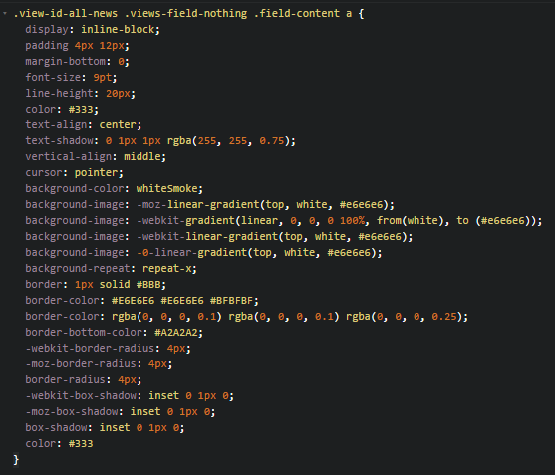

What we see
Too complex, too long
Difficult to maintain
What if customer want to change a color in project?
Ctrl + R => replace all?
6/15/15
www.qsoftvietnam.com
22

Slide 23
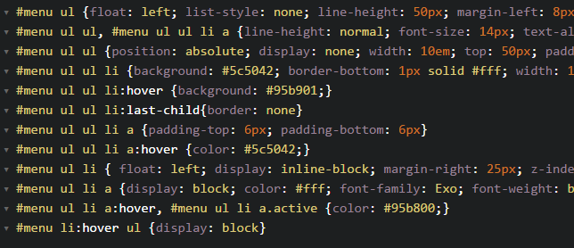
Dupplicate, hard to read
6/15/15
www.qsoftvietnam.com
23

Slide 24
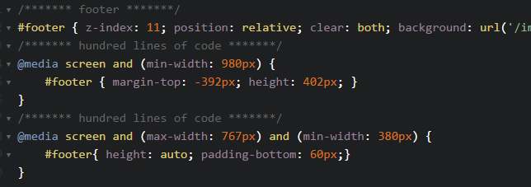
Waste of time
6/15/15
www.qsoftvietnam.com
24

Slide 25
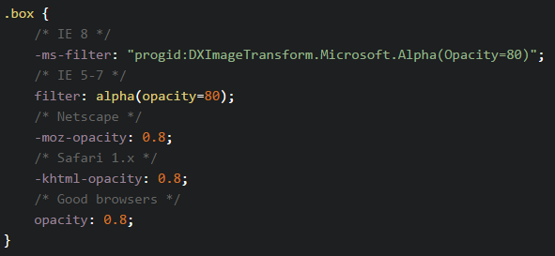
Hard to implement
6/15/15
www.qsoftvietnam.com
25

Slide 26
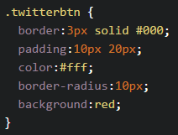
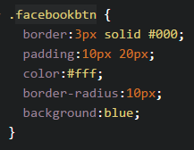


No re-use, just copy & paste
6/15/15
www.qsoftvietnam.com
26

Slide 27
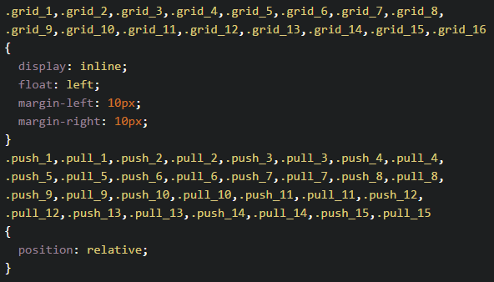
Oh my god, no looping function
6/15/15
www.qsoftvietnam.com
27

Slide 28
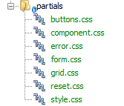
Separate CSS are good enough?
=> HTTP requests problem
6/15/15
www.qsoftvietnam.com
28

Slide 29
What we need?
Easy to change/maintain (Variable)
Easy to read (Nesting)
Easy to write (Mixins)
No duplicate, reusable code (Extend/Inheritance)
Easy to organize, fewer requests (Partials, Import)
Powerful (Operators, Condition, Loop)
6/15/15
www.qsoftvietnam.com
29

Slide 30
Object-oriented CSS
Why we need Sass
Introduction to Sass
Part I
Variable, Nest, Mixin
Extend, Import

Slide 31

Introduction to
6/15/15
www.qsoftvietnam.com
31

Slide 32
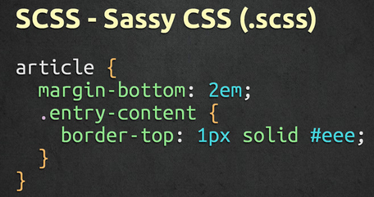
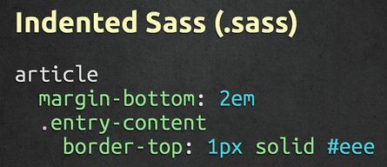
What is Sass
Syntactically Awesome StyleSheets
Simple but powerful syntax for creating manageable CSS
Too “flavors” – SASS & SCSS
6/15/15
www.qsoftvietnam.com
32

Slide 33
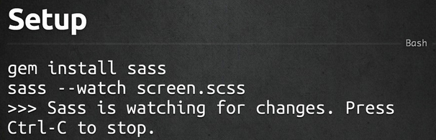
How to install
6/15/15
www.qsoftvietnam.com
33

Slide 34

Sass work flow
6/15/15
www.qsoftvietnam.com
34

Slide 35
Object-oriented CSS
Why we need Sass
Introduction to Sass
Part I
Variable, Nest, Mixin
Extend, Import

Slide 36

6/15/15
www.qsoftvietnam.com
36

Slide 37
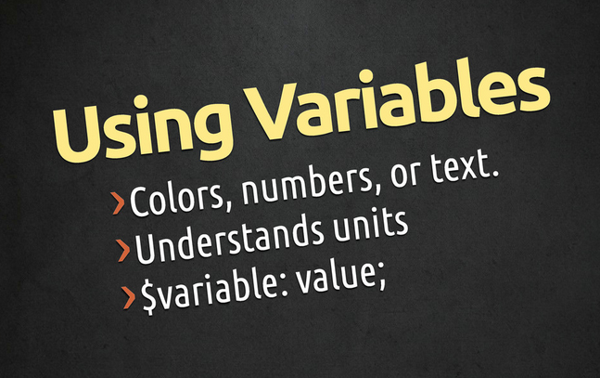
6/15/15
www.qsoftvietnam.com
37

Slide 38
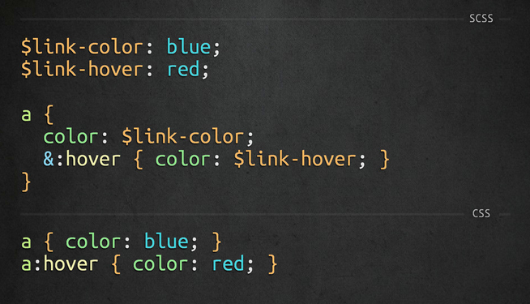
6/15/15
www.qsoftvietnam.com
38

Slide 39
Object-oriented CSS
Why we need Sass
Introduction to Sass
Part I
Variable, Nest, Mixin
Extend, Import

Slide 40

6/15/15
www.qsoftvietnam.com
40

Slide 41
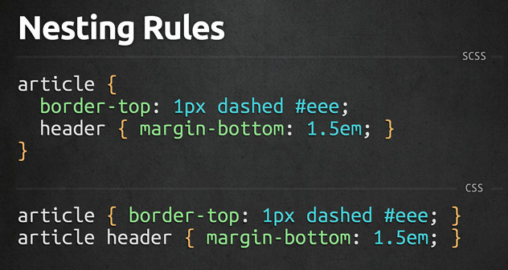
6/15/15
www.qsoftvietnam.com
41

Slide 42
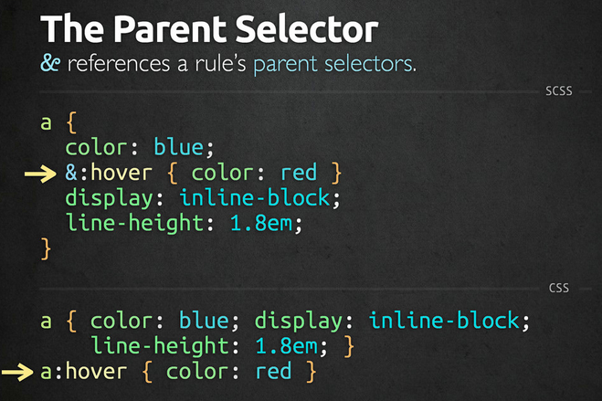
6/15/15
www.qsoftvietnam.com
42

Slide 43
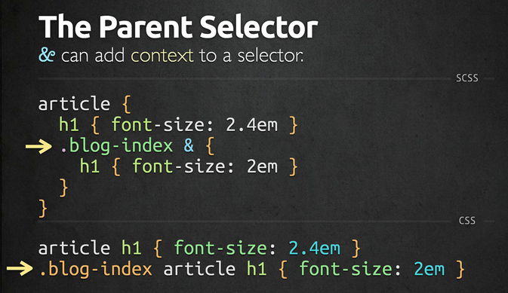
6/15/15
www.qsoftvietnam.com
43

Slide 44
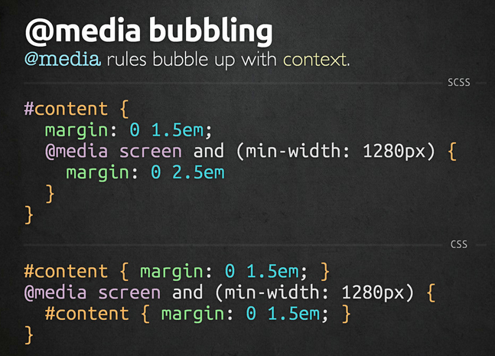
6/15/15
www.qsoftvietnam.com
44

Slide 45
Object-oriented CSS
Why we need Sass
Introduction to Sass
Part I
Variable, Nest, Mixin
Extend, Import

Slide 46

6/15/15
www.qsoftvietnam.com
46

Slide 47
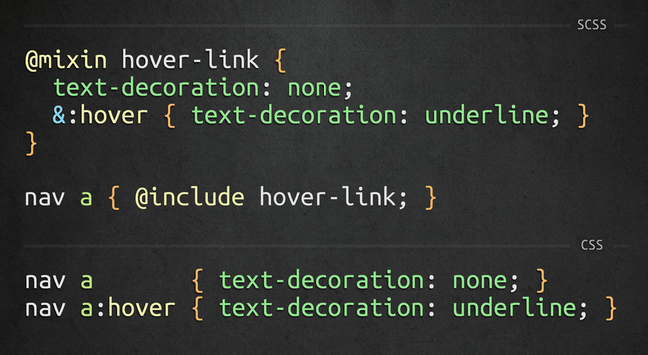
6/15/15
www.qsoftvietnam.com
47

Slide 48
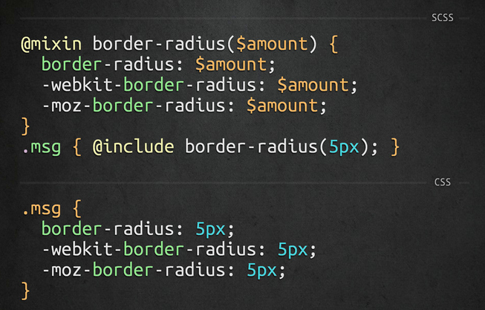
6/15/15
www.qsoftvietnam.com
48

Slide 49
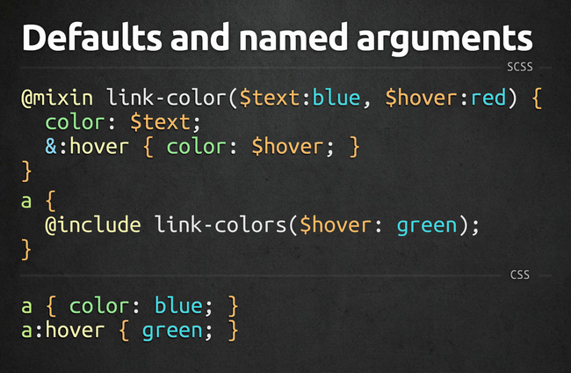
6/15/15
www.qsoftvietnam.com
49

Slide 50
Object-oriented CSS
Why we need Sass
Introduction to Sass
Part I
Variable, Nest, Mixin
Extend, Import

Slide 51

6/15/15
www.qsoftvietnam.com
51

Slide 52
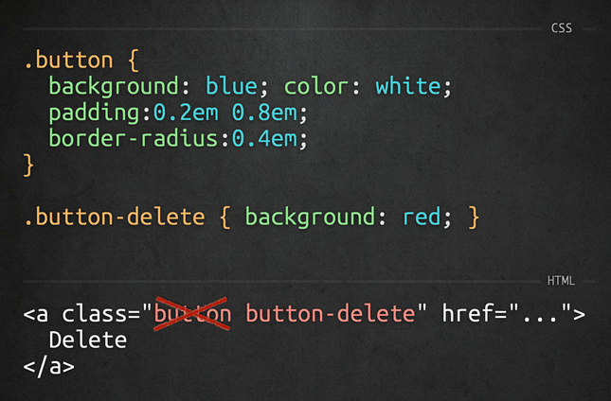
6/15/15
www.qsoftvietnam.com
52

Slide 53
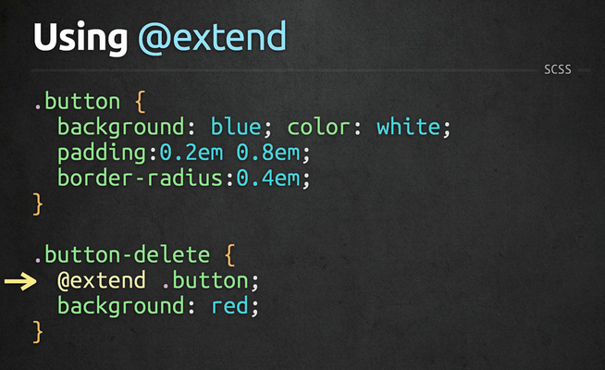
6/15/15
www.qsoftvietnam.com
53

Slide 54
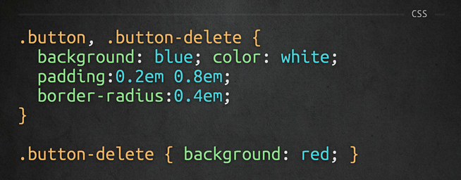
6/15/15
www.qsoftvietnam.com
54

Slide 55
Object-oriented CSS
Why we need Sass
Introduction to Sass
Part I
Variable, Nest, Mixin
Extend, Import

Slide 56

6/15/15
www.qsoftvietnam.com
56

Slide 57
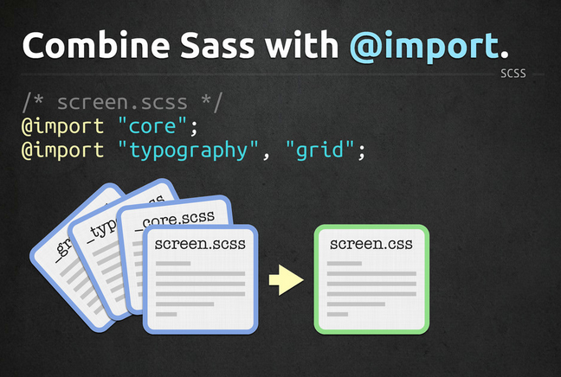
6/15/15
www.qsoftvietnam.com
57

Slide 58
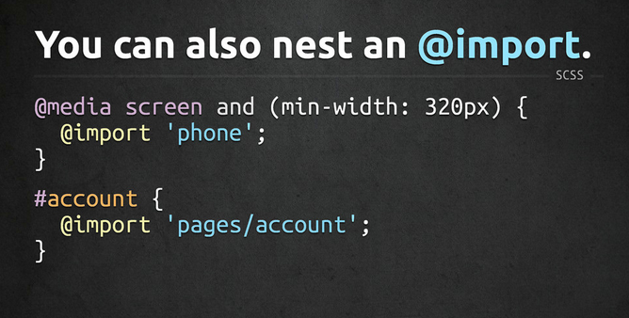
6/15/15
www.qsoftvietnam.com
58

Slide 59
Object-oriented CSS
Why we need Sass
Introduction to Sass
Part I
Variable, Nest, Mixin
Extend, Import

Slide 60
Math, Loop, Condition, Function
Introduction to Compass
Disadvantages of Sass
Part II
Sass Vs Less
Tool, Cheat sheet, Best practices

Slide 61

6/15/15
www.qsoftvietnam.com
61

Slide 62
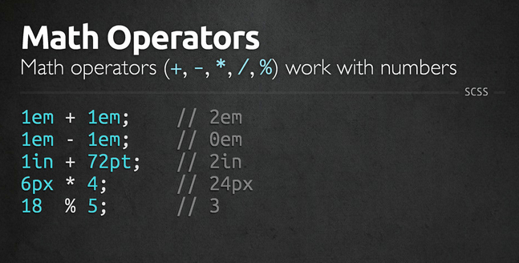
6/15/15
www.qsoftvietnam.com
62

Slide 63
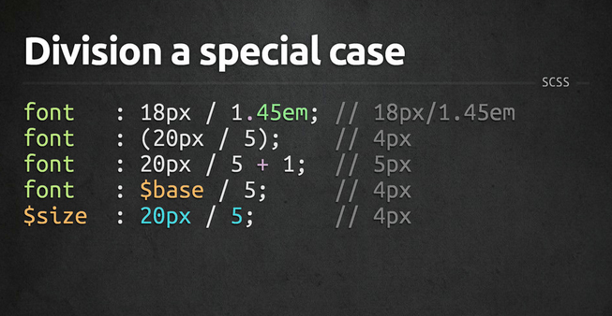
6/15/15
www.qsoftvietnam.com
63

Slide 64
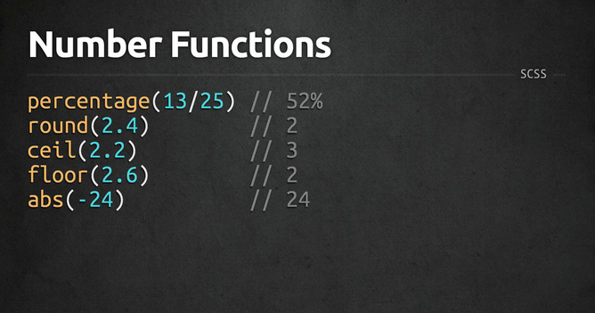
6/15/15
www.qsoftvietnam.com
64

Slide 65
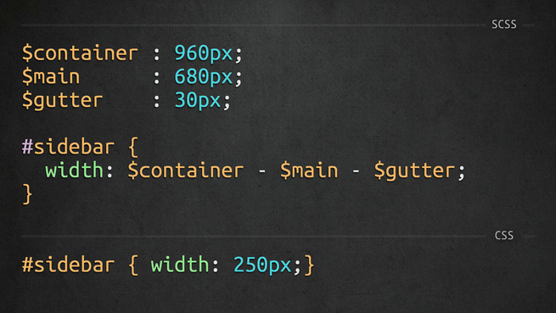
6/15/15
www.qsoftvietnam.com
65

Slide 66
Math, Loop, Condition, Function
Introduction to Compass
Disadvantages of Sass
Part II
Sass Vs Less
Tool, Cheat sheet, Best practices

Slide 67

6/15/15
www.qsoftvietnam.com
67

Slide 68

6/15/15
www.qsoftvietnam.com
68

Slide 69
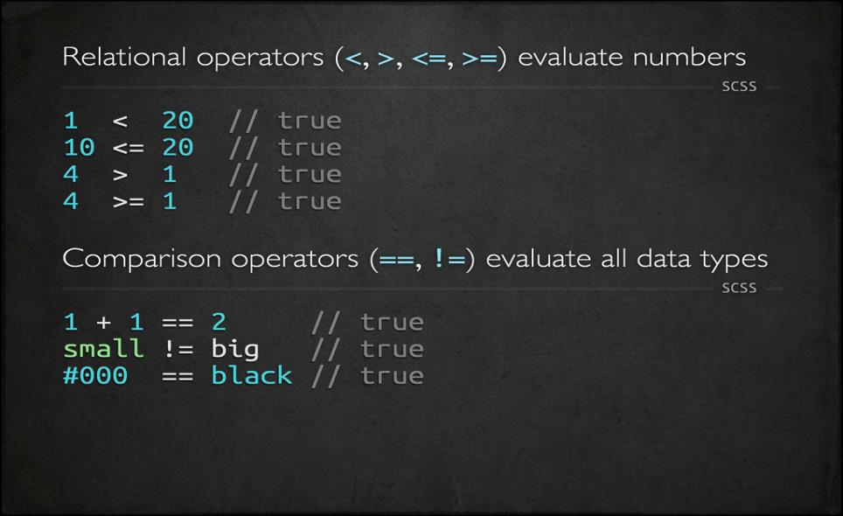
6/15/15
www.qsoftvietnam.com
69

Slide 70
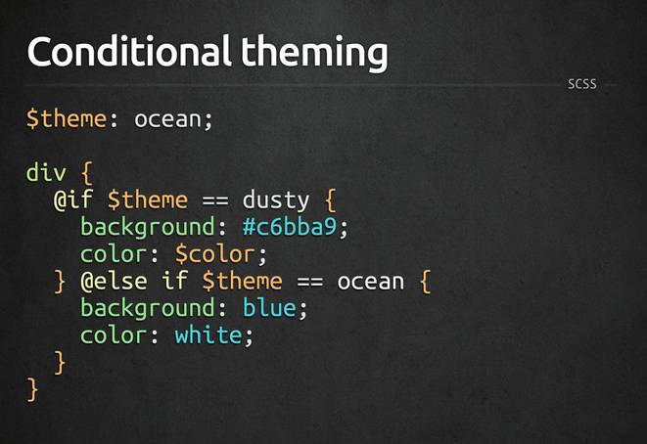
6/15/15
www.qsoftvietnam.com
70

Slide 71
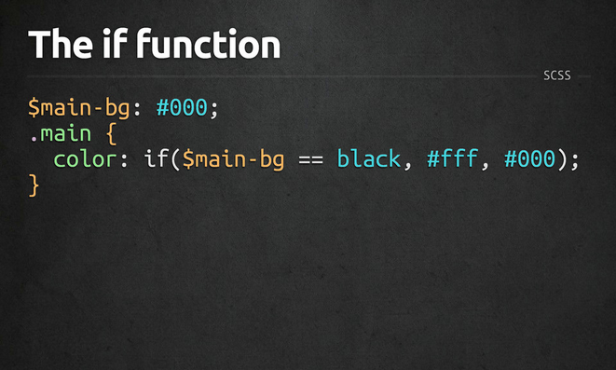
6/15/15
www.qsoftvietnam.com
71

Slide 72
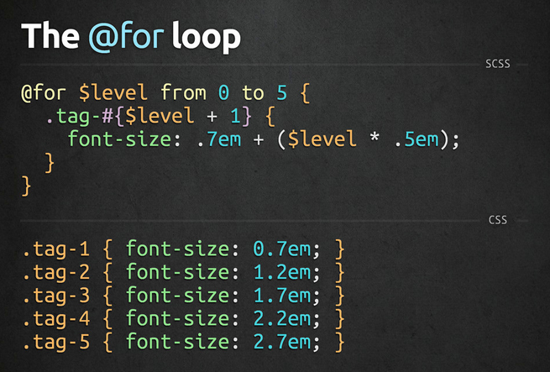
6/15/15
www.qsoftvietnam.com
72

Slide 73
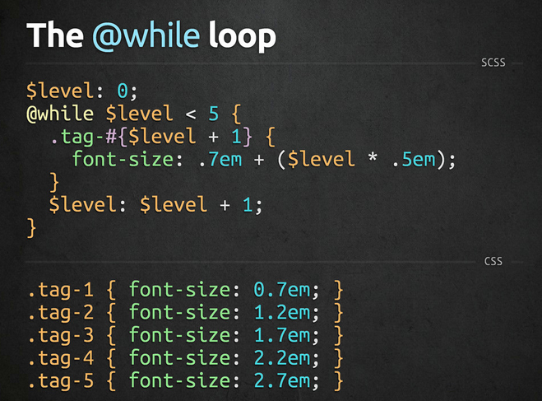
6/15/15
www.qsoftvietnam.com
73

Slide 74
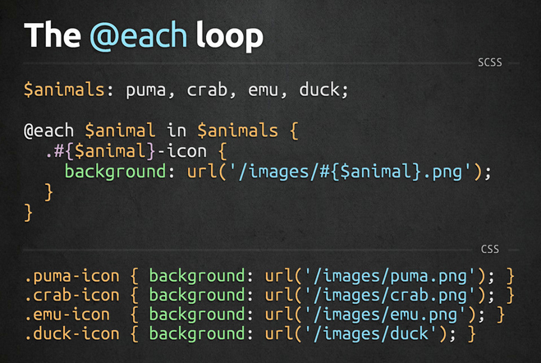
6/15/15
www.qsoftvietnam.com
74

Slide 75

6/15/15
www.qsoftvietnam.com
75

Slide 76
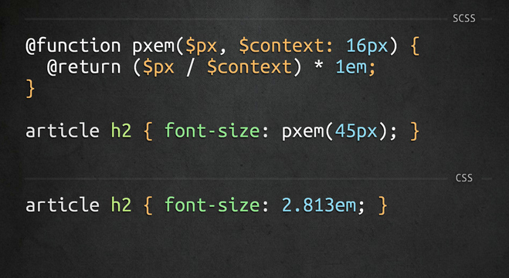
6/15/15
www.qsoftvietnam.com
76

Slide 77
Math, Loop, Condition, Function
Introduction to Compass
Disadvantages of Sass
Part II
Sass Vs Less
Tool, Cheat sheet, Best practices

Slide 78

Introduction to
6/15/15
www.qsoftvietnam.com
78
Notes:
http://compass-style.org/reference/compass/css3/
78

Slide 79
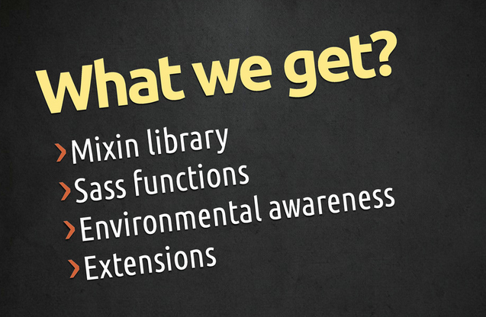
6/15/15
www.qsoftvietnam.com
79

Slide 80
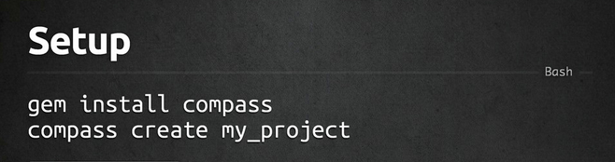
How to install
6/15/15
www.qsoftvietnam.com
80

Slide 81
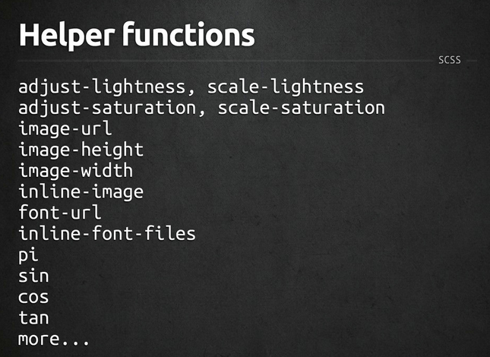
6/15/15
www.qsoftvietnam.com
81

Slide 82
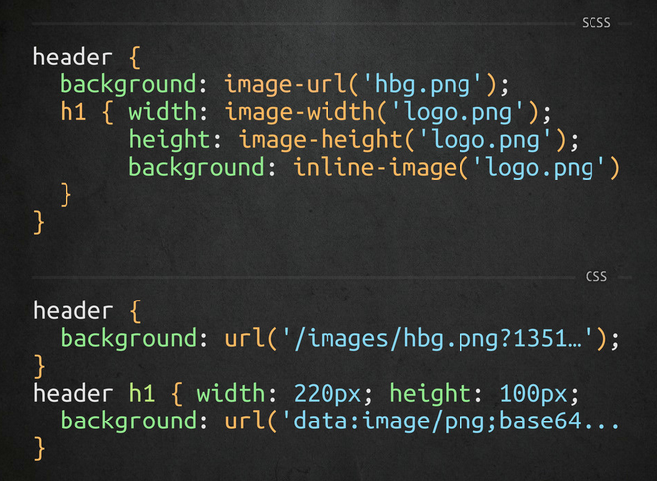
6/15/15
www.qsoftvietnam.com
82

Slide 83
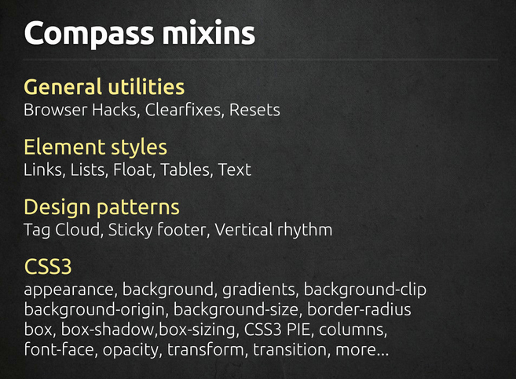
6/15/15
www.qsoftvietnam.com
83

Slide 84

6/15/15
www.qsoftvietnam.com
84

Slide 85
Math, Loop, Condition, Function
Introduction to Compass
Disadvantages of Sass
Part II
Sass Vs Less
Tool, Cheat sheet, Best practices

Slide 86
Disadvantages
Not for beginners:
Need basic CSS, time to understand SASS
Need basic programming knowledge (problem for designer)
Need installation/environment setup
Need time to compile
A little bit hard to debug
Can’t edit on live server (nah, you shouldn’t do that)
6/15/15
www.qsoftvietnam.com
86

Slide 87
Math, Loop, Condition, Function
Introduction to Compass
Disadvantages of Sass
Part II
Sass Vs Less
Tool, Cheat sheet, Best practices

Slide 88

LESS Condition
6/15/15
www.qsoftvietnam.com
88
Notes:
http://www.zingdesign.com/less-vs-sass-its-time-to-switch-to-sass/
https://css-tricks.com/sass-vs-less/
https://gist.github.com/chriseppstein/674726

Slide 89

LESS Loop
6/15/15
www.qsoftvietnam.com
89
Notes:
http://www.zingdesign.com/less-vs-sass-its-time-to-switch-to-sass/
https://css-tricks.com/sass-vs-less/
https://gist.github.com/chriseppstein/674726

Slide 90

LESS Loop
6/15/15
www.qsoftvietnam.com
90
Notes:
http://www.zingdesign.com/less-vs-sass-its-time-to-switch-to-sass/
https://css-tricks.com/sass-vs-less/
https://gist.github.com/chriseppstein/674726

Slide 91
Sass VS Less
 | SASS | LESS | Winner
Environment | Ruby | Javascript | Nobody
Helping with CSS3 | Compass, Bourbon | LESS Elements | SASS
Language Ability | If, else, elseif, for, while, each | when | SASS
Generate code (@extend) | Copy paste like mixin of Sass | Group same code Silent extend | SASS
Variable | $variable | @variable (@keyframes, @media) | Nobody
6/15/15
www.qsoftvietnam.com
91
Notes:
http://www.zingdesign.com/less-vs-sass-its-time-to-switch-to-sass/
https://css-tricks.com/sass-vs-less/
https://gist.github.com/chriseppstein/674726

Slide 92
Math, Loop, Condition, Function
Introduction to Compass
Disadvantages of Sass
Part II
Sass Vs Less
Tool, Cheat sheet, Best practices

Slide 93
Sass Tools
Prepros
Livereload
Hammer
Koala
Scout
Bourbon
6/15/15
www.qsoftvietnam.com
93

Slide 94
Sass Tools
Compile SASS to CSS
Add mixins, functions, helpers
Add compass, autoPrefix, SourceMaps
Output style: Compressed, Compact, Nested, Expended
6/15/15
www.qsoftvietnam.com
94

Slide 95

6/15/15
www.qsoftvietnam.com
95

Slide 96

Sass Cheatsheet
http://jurs.me/scss-cheat-sheet/
http://sass-cheatsheet.brunoscopelliti.com/
http://www.cheatography.com/tag/sass/
Notes:
http://codepen.io/quangsonpro/public-titles-asc/

Slide 97
Sass Best Practices
Nest only when necessary
No more than 4 levels deep
Before writing a custom mixin, look for it in compass
http://compass-style.org/reference/compass/css3/
Variable naming convention ${modifer(s)}-{name}
$link-color, $dark-link-color, $large-border-radius
Don’t reduce mixin usage, use params input
Extend is better than mixin
Notes:
http://codepen.io/quangsonpro/public-titles-asc/

Slide 98


Sass Best Practices
Notes:
http://codepen.io/quangsonpro/public-titles-asc/

Slide 99

Notes:
http://codepen.io/quangsonpro/public-titles-asc/

Slide 100

Notes:
http://codepen.io/quangsonpro/public-titles-asc/

Slide 101

Notes:
http://codepen.io/quangsonpro/public-titles-asc/

Slide 102
Notes:
http://codepen.io/quangsonpro/public-titles-asc/

Slide 103
Sass Best Practices
Keep Things Simple
Notes:
The simple as possible. The purpose of Sass is to write cleaner more manageable CSS. Before creating any new mixins, variables, or functions, ensure that their presence will enhancconcluding point I’ll make in this post is to keep things as e development and not overcomplicate things. All Sass features are useful when used in the correct situations and in moderation.
Creating an endless list of variables without clear usage, or a complex function that is difficult to understand for anyone other than the author is not the intention and will not aid development or produce DRY CSS.

Slide 104

Combination
Html
Haml
Markdown
Slim
Jade
CSS
Less
SCSS
SASS
Stylus
Javascript
CoffeeScript
LiveScript
TypeScript
Babel
Notes:
The simple as possible. The purpose of Sass is to write cleaner more manageable CSS. Before creating any new mixins, variables, or functions, ensure that their presence will enhancconcluding point I’ll make in this post is to keep things as e development and not overcomplicate things. All Sass features are useful when used in the correct situations and in moderation.
Creating an endless list of variables without clear usage, or a complex function that is difficult to understand for anyone other than the author is not the intention and will not aid development or produce DRY CSS.
http://codepen.io/drshoggoth/pen/upnFx

Slide 105
THANK YOU FOR YOUR ATTENTION!
6/15/15
www.qsoftvietnam.com
105

